Slide 1



Peter Eijgermans
@EijgermansPeter

Slide 2

Agenda workshop
Choose your framework, ReactJS or Vue.js!
Component tree
Explain Vue.js
Explain ReactJS
Start Workshop

Slide 3
Building Tesla’s Battery Range Calculator with Vue

Slide 4
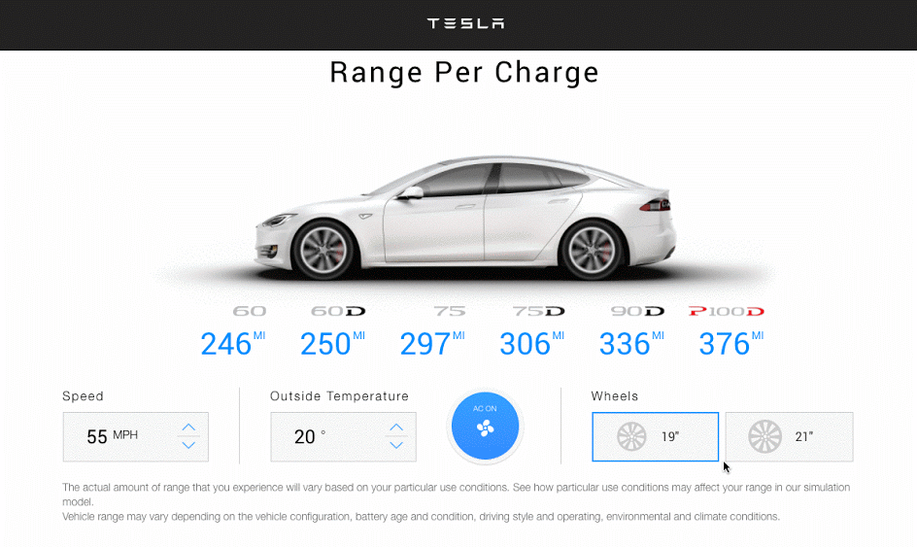

Slide 5
What to install?
Install node (https://nodejs.org/)

Slide 6
Getting Started
https://github.com/petereijgermans11/workshop-reactjs-vuejs
cd workshop-reactjs-vuejs
cd ./vuejs-app
npm i yarn
yarn
yarn start

Slide 7


Component based
Focused on the view layer (all browsers)
Integration with Angular or React
Small and compact (21 Kb)

Slide 8
root Vue Instance
var app = new Vue({
….
})
Notes:
To start with VueJS, we need to create the instance of Vue, which is called the root Vue Instance.

Slide 9
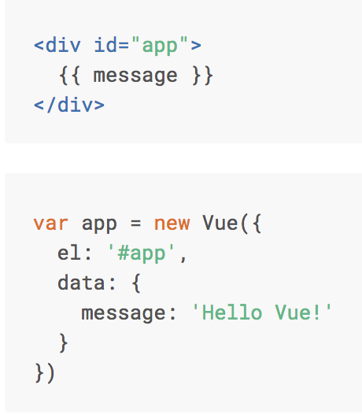

Basics Vue.js
Notes:
Here we create an instance of Vue.
For Vue, there is a parameter called el. It takes the id of the div-element.
Next, we have defined the data-object. The data-object => represents the MODEL => represents the STATE of your component
It has a property : message -> value: ‘message’
This value will be rendered in the View via ‘interpolation’ {{}}

Slide 10
Interpolation
<span> Message: {{ message }} </span>

Slide 12
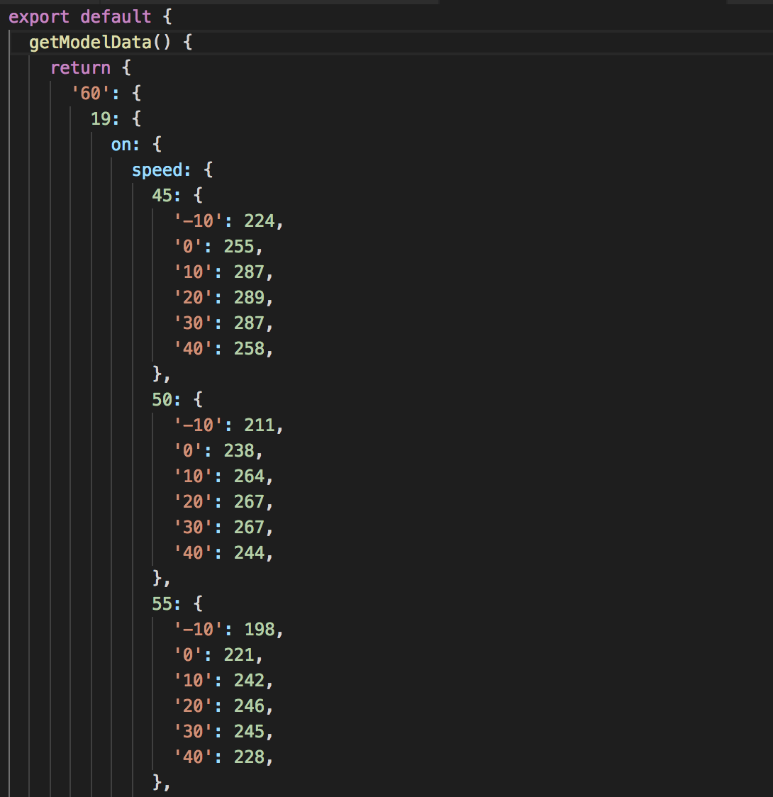

Slide 13
Component based A component adds logic to DOM elements
Notes:
Components are one of the important features of Vue.js that helps create custom elements, which can be reused in HTML.

Slide 14
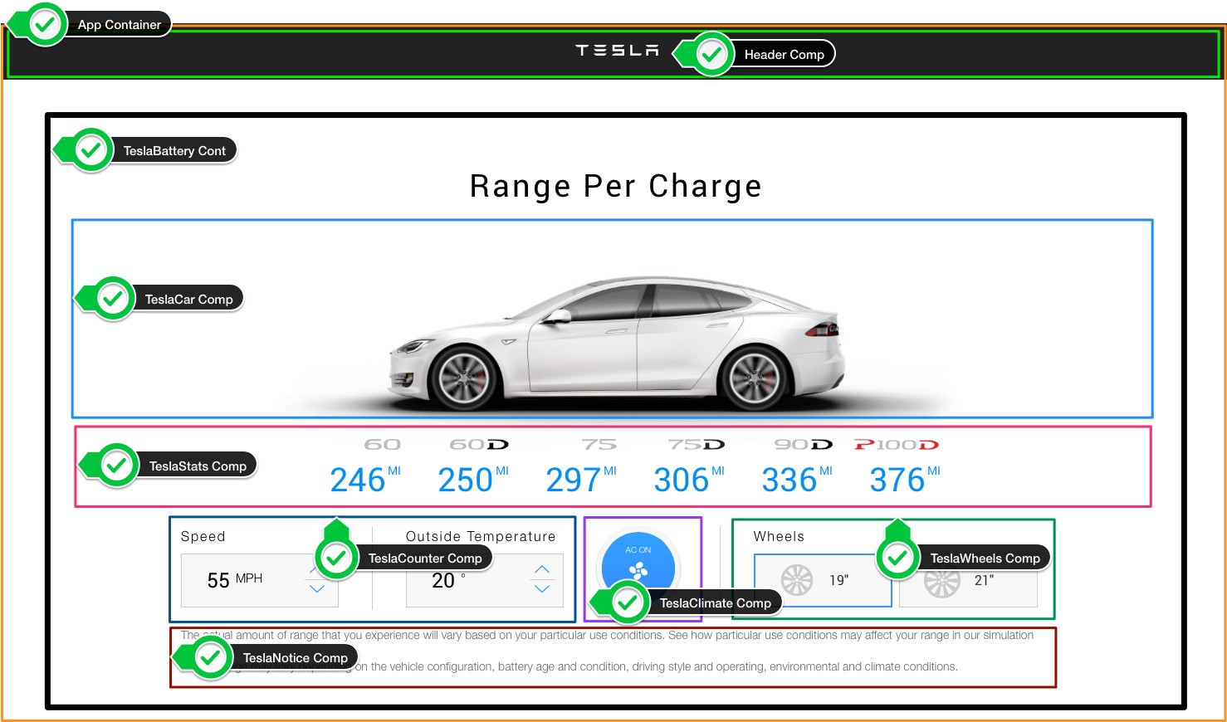

Slide 15
The UI is represented by a component tree
<App> --- Application entry point <TeslaHeader></TeslaHeader> <TeslaBattery> --- Container Component <TeslaCar /> --- Presentational Component <TeslaStats /> --- Presentational Component <TeslaCounter /> --- Presentational Component <TeslaClimate /> --- Presentational Component <TeslaWheels /> --- Presentational Component <TeslaNotice /> --- Presentational Component </TeslaBattery> </App>

Slide 16
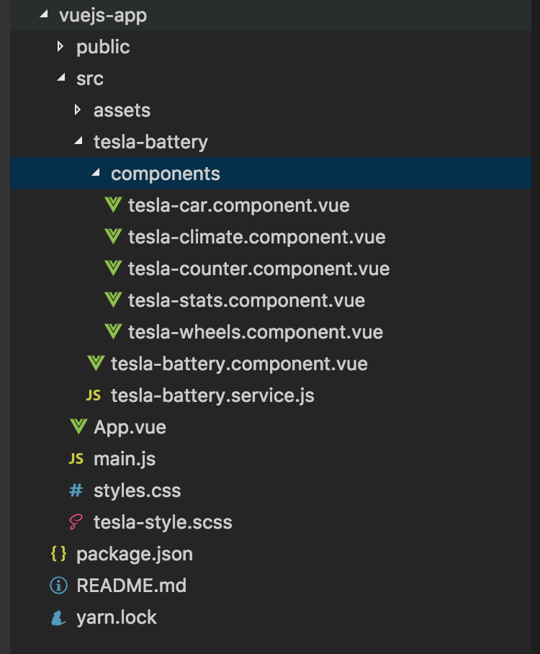

Slide 17
Components tree
main.js
App.vue
TeslaBattery
→ Container Component
props
props
props
props
props
TeslaCar
TeslaStats
TeslaCounter
TeslaClimate
TeslaWheels
Presentational Components

Slide 18
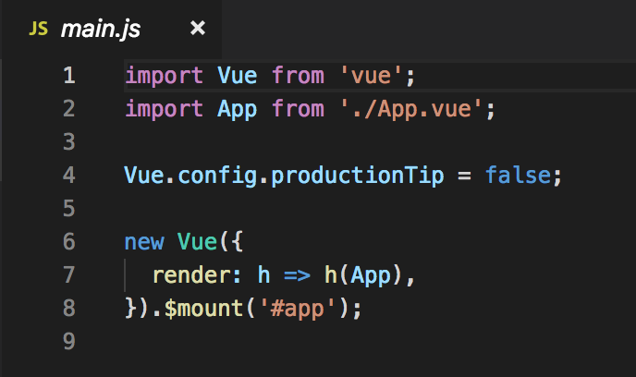
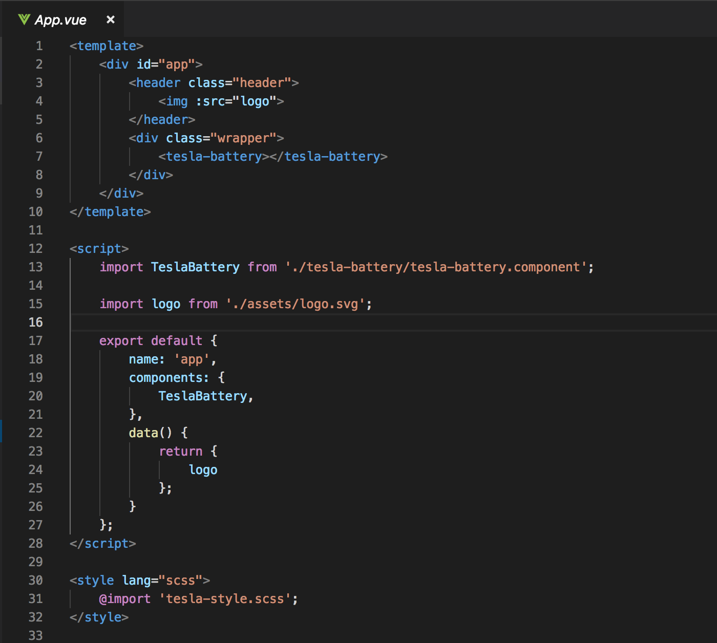
Entry Point
main.js
App.vue
Notes:
The main.js file is the entry point of the site, it is here that your first component is mounted and rendered.
App.vue is the first component mounted by Vue.
This component consist of the tesla-battery.component.

Slide 19
Components tree
Main.js
App.vue
TeslaBattery
props
props
props
props
props
TeslaCar
TeslaStats
TeslaCounter
TeslaClimate
TeslaWheels

Slide 20
Tesla Battery Component
Provides:
data = state
props
actions (changes state)
Notes:
Tesla Battery Component
Provides data
Passing this data via props to child components
Performing actions via callback functions (to change the state)

Slide 21
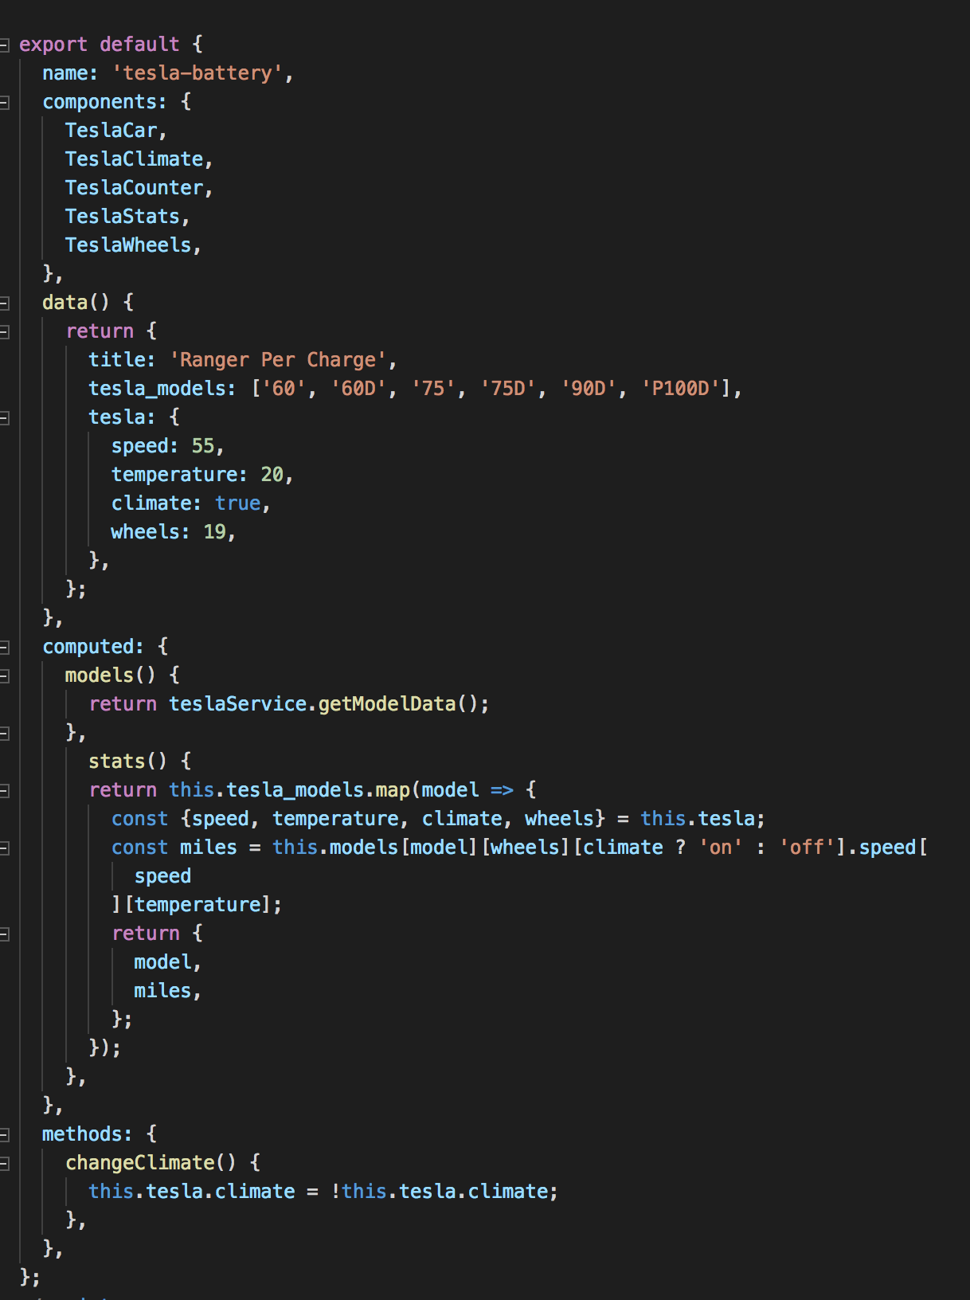
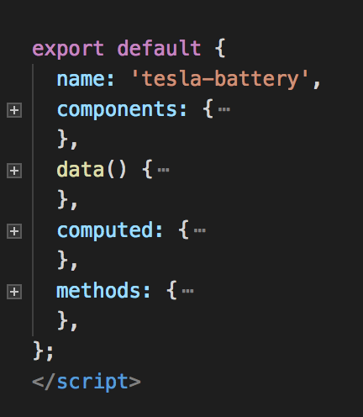
Tesla Battery Component
Notes:
This is the container component.
The tesla-battery.component: Provides data and actions to child/presentational components.
COMPUTED vs METHODS:
However, the difference is that computed properties are cached based on their dependencies. A computed property will only re-evaluate when some of its dependencies have changed. This means as long as message has not changed, multiple access to the reversedMessage computed property will immediately return the previously computed result without having to run the function again.

Slide 22
State of the App
stats()-function: calculating the maximum battery range per model. This range is based on the user input (wheelsize – climate – speed - temp)
tesla (object): Currently selected conditions object (speed: 55, temperature: 20, climate: aricon on, wheel: 19)

Slide 23
stats()-function
[
{"model":"60","miles":267},
{"model":"60D","miles":271},
{"model":"75","miles":323},
{"model":"75D","miles":332},
{"model":"90D","miles":365},
{"model":"P100D","miles":409}
]

Slide 24
Tesla Battery Service

Slide 25
Notes:
Models
–> wheelsize
–> climate
–> speed
--> temparature

Slide 26
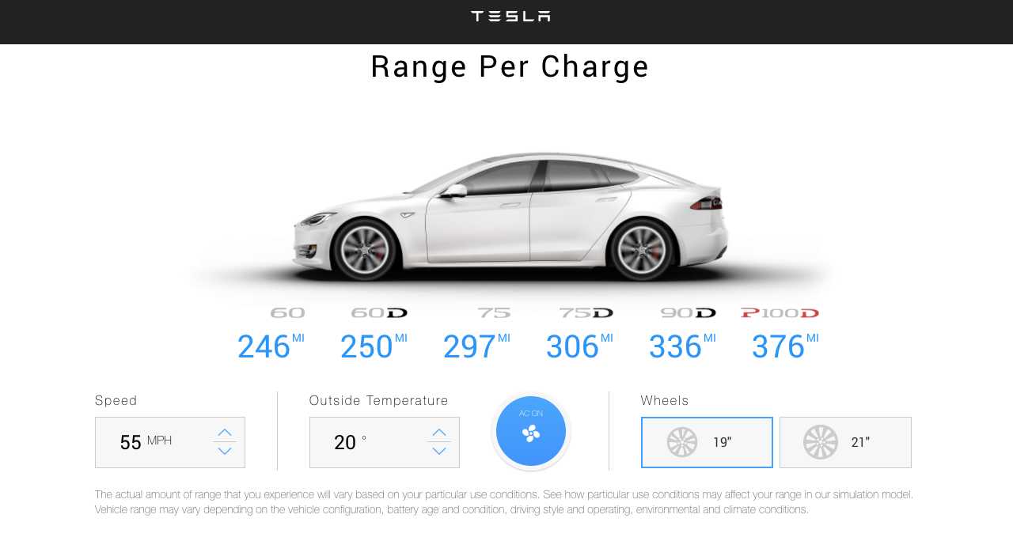
Exercise: check Tesla Battery Service

Slide 27
passing props to child components
Main.js
Use v-bind or :
to pass props
App.vue
TeslaBattery
props
:wheelsize
:speed
props
props
props
props
TeslaCar
TeslaStats
TeslaCounter
TeslaClimate
TeslaWheels
Notes:
Get properties from parent component

Slide 28
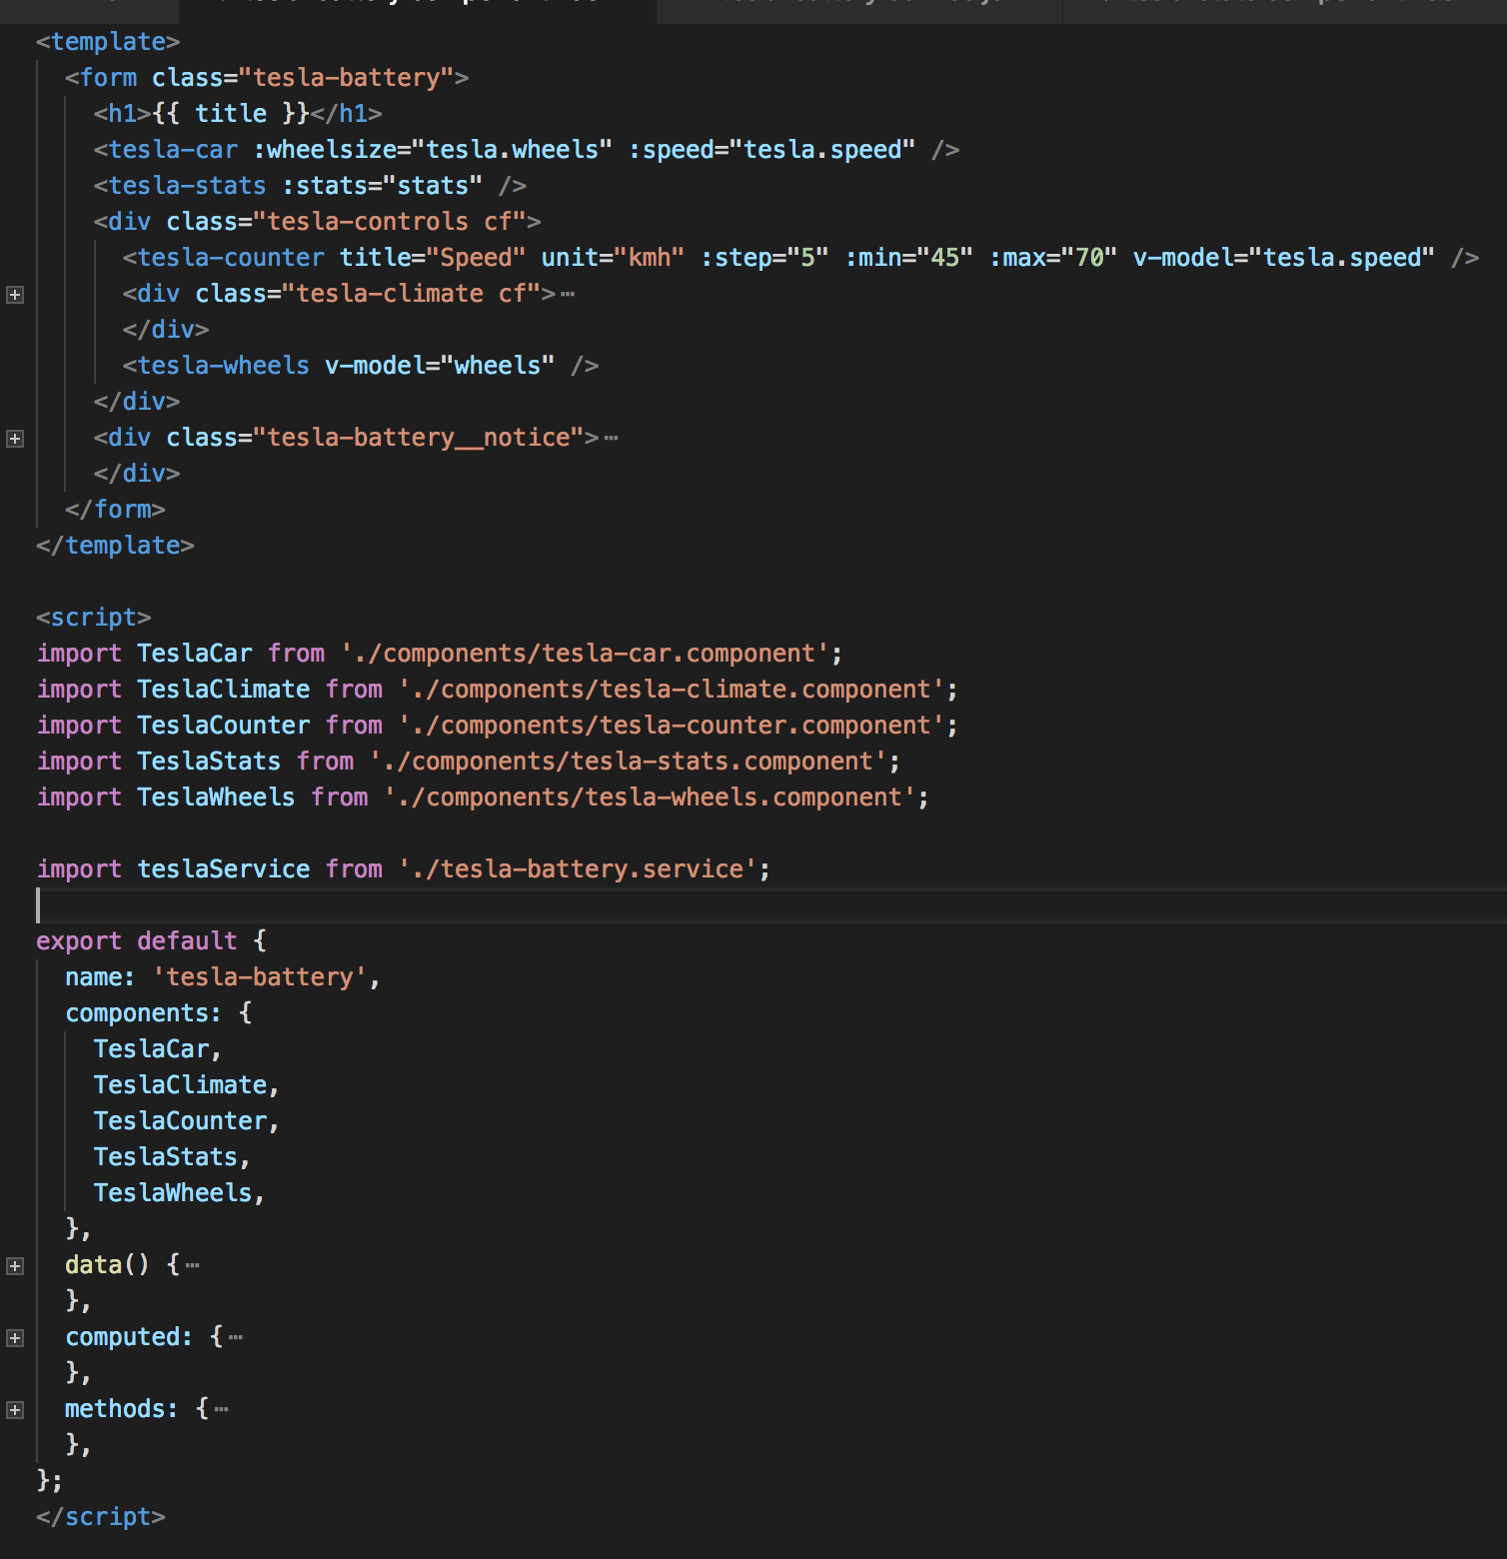
Tesla Battery Component passing props to Tesla Car Component
:wheelsize = [19,21]
:speed = [45,50,55,60,65]

Slide 29
Receiving props in Tesla Car Component

Slide 30
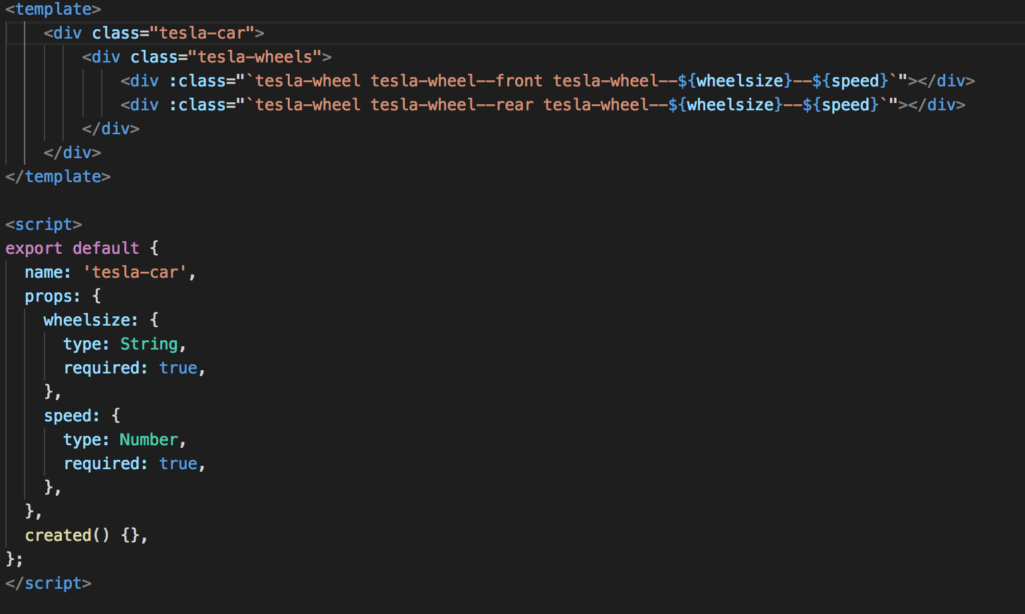
Receiving props in Tesla Car Component
<tesla-car :wheelsize="tesla.wheels" :speed="tesla.speed" />
Notes:
Receiving props via the ‘props’ section !!!

Slide 31
Components are like JavaScript functions
fn(d) = V
Notes:
Component = A function that receives data as input and returns a view.

Slide 32
Tesla Stats Component

Slide 33
passing props to child components
Main.js
Use v-bind or :
to pass props
App.vue
TeslaBattery
props
props
:stats
props
props
props
TeslaCar
TeslaStats
TeslaCounter
TeslaClimate
TeslaWheels

Slide 35
Tesla Battery Component passing props to Tesla Stats Component
:stats = Array
[
{"model":"60","miles":267},
{"model":"60D","miles":271},
{"model":"75","miles":323},
{"model":"75D","miles":332},
{"model":"90D","miles":365},
{"model":"P100D","miles":409}
]

Slide 36
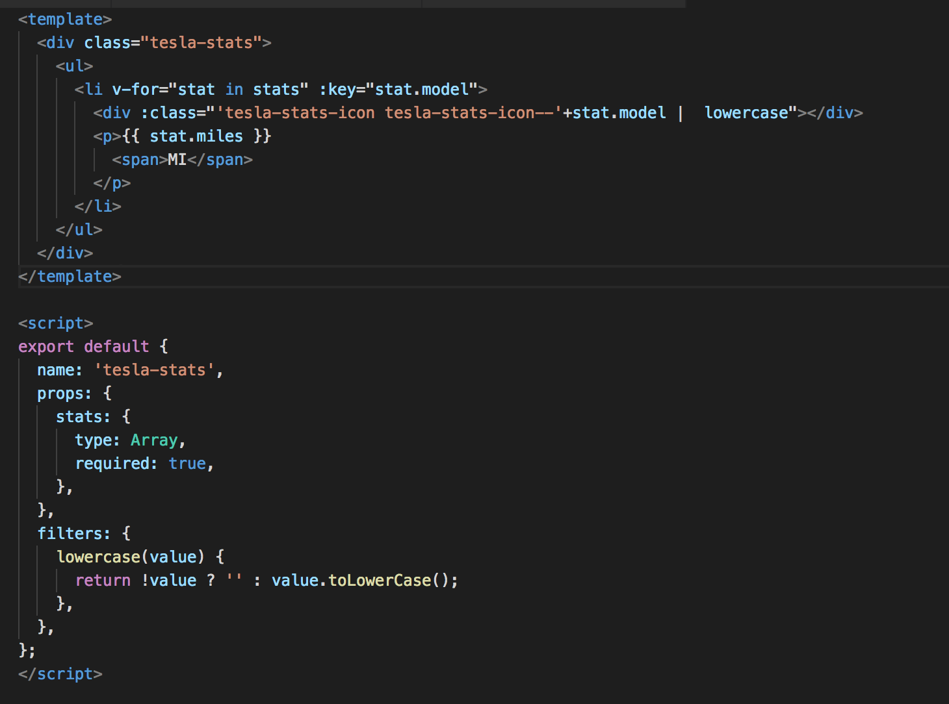
Receiving props in Tesla Stats Component
v-for=“stat in stats” :key
stats (type: Array)
Notes:
:class

Slide 37
v-for directive
<li v-for="stat in stats" :key="stat.model">
<p>{{ stat.miles | km }}</p> --> filter
</li>
…..
filters: {
km(value) {
return Math.floor(value * 1.609344);
},
}

Slide 38
Components are like JavaScript functions
fn(d) = V
Notes:
Component = A function that receives data as input and returns a view.

Slide 39
v-model
2-way databinding

Slide 40
2-way databinding
App.vue
props
TeslaHeader
TeslaBattery
props
props
props
props
:speed
$emit
speed
TeslaCar
TeslaStats
TeslaCounter
TeslaClimate
TeslaWheels

Slide 41
v-model (2-way databinding)
Components compatible with v-model:
accept a :value property
emit an @input event
Notes:
emit an @input event when the user changes the value

Slide 42
Tesla Counter Component

Slide 44
v-model Tesla Counter Component
v-model=“tesla.speed”

Slide 45
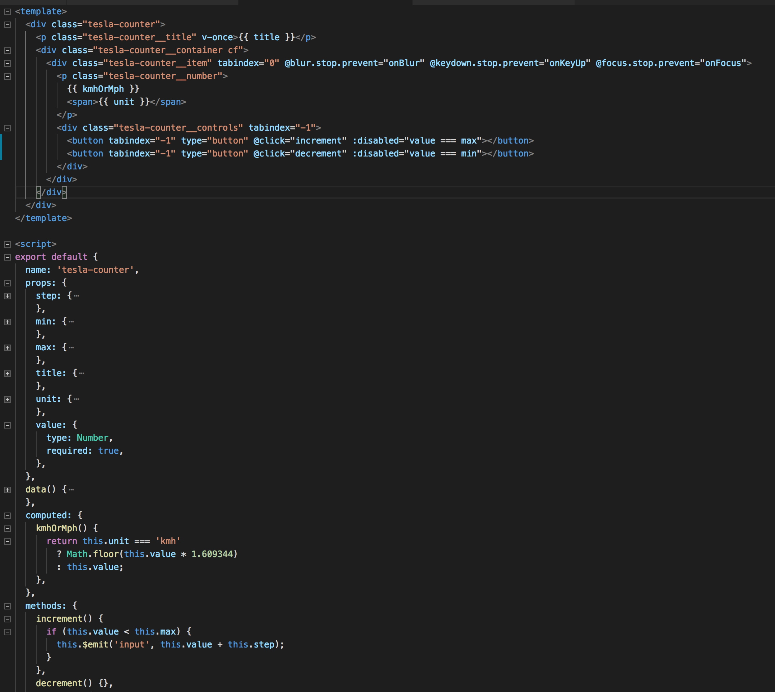
v-model in Tesla Counter Component
@click =“increment”
prop: value
this.$emit('input', this.value)
Notes:
The value/speed is emitted back to the parent component

Slide 46
Tesla Header Component

Slide 47
How to create a tesla.header.component?
App.vue
props: :greeting
TeslaHeader
TeslaBattery
props
props
props
props
props
TeslaCar
TeslaStats
TeslaCounter
TeslaClimate
TeslaWheels
Notes:
To create a tesla.header.component we will pass a ‘greeting’ property from the App.vue to the tesla.header.component

Slide 48
tesla-header.component
Step1 Create tesla-header.component.vue
Step 2 Import tesla-header.component in App.vue

Slide 49
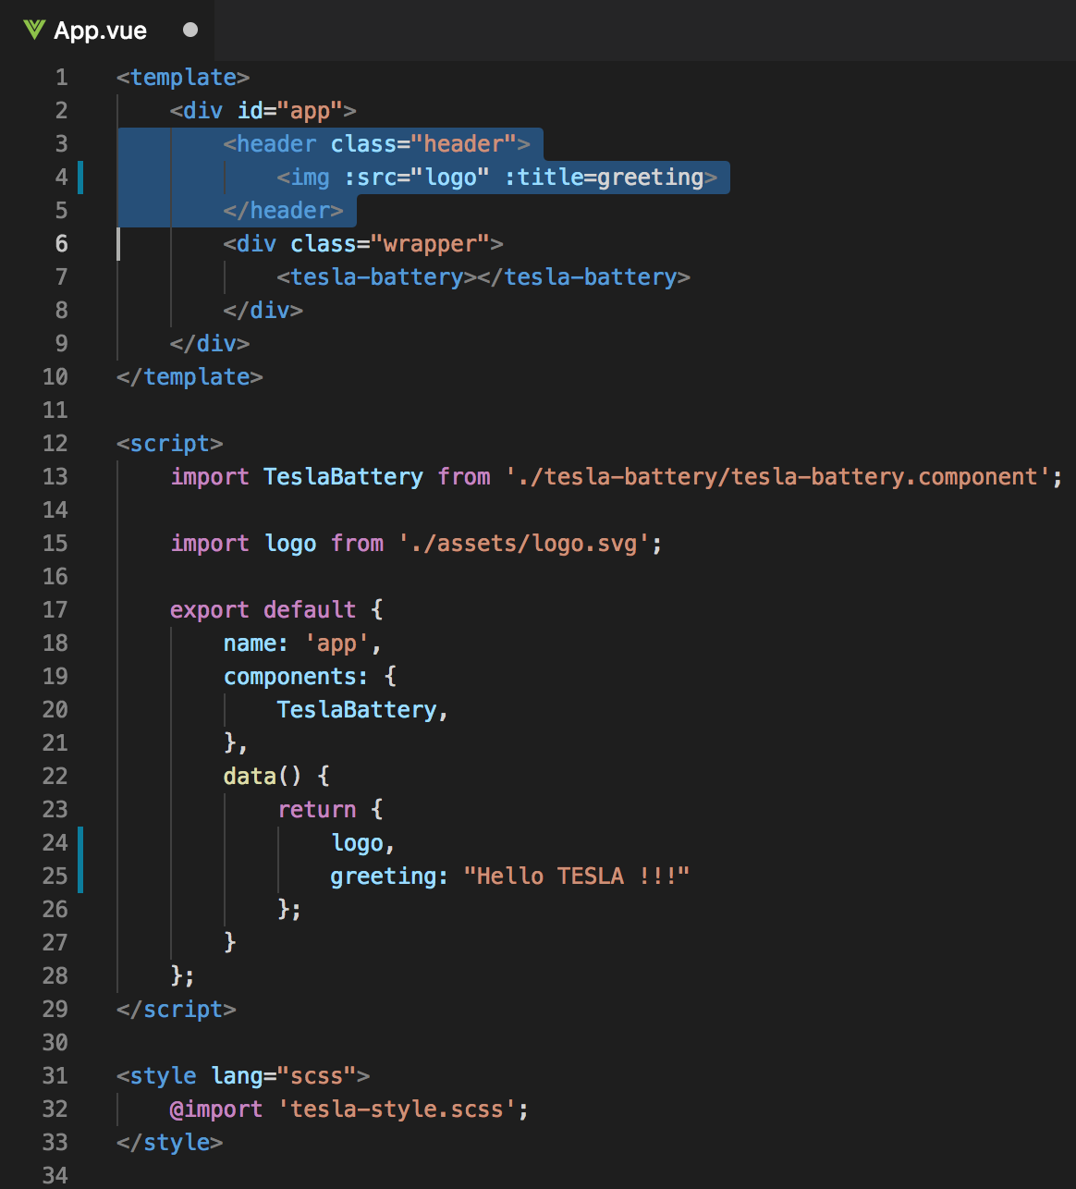
Current App.vue
<img v-bind:src=“logo” v-bind:title=“greeting”>
Notes:
We will store the img src in the data object
To assign the ’logo’ and ‘greeting’ attribute to HMTL tag, we need to use v-bind directive or colon.

Slide 50
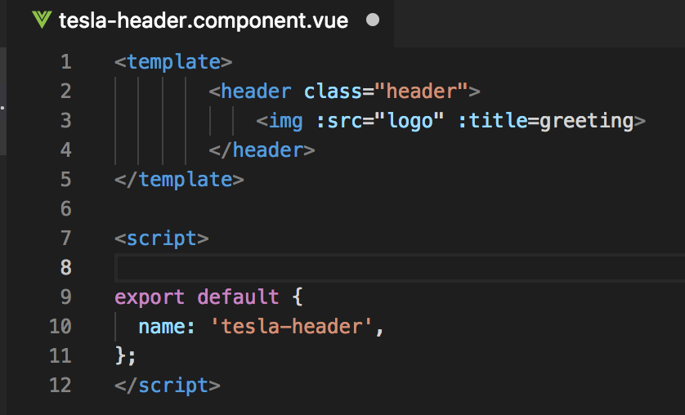
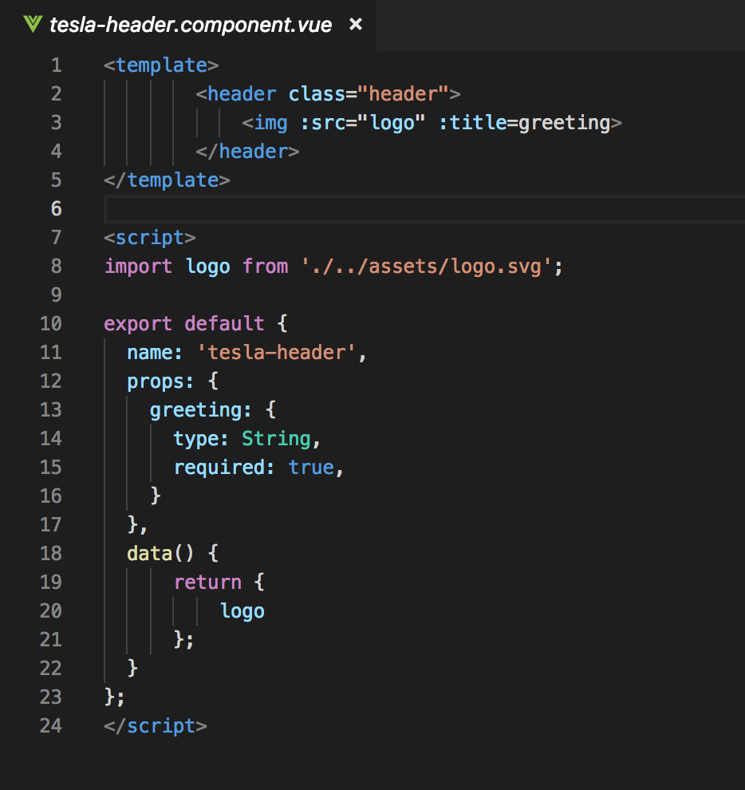
Step1 Create: tesla-header.component.vue
Notes:
Name
Props → logo

Slide 51
Components tree
App.vue
props: :greeting
TeslaHeader
TeslaBattery
props
props
props
props
props
TeslaCar
TeslaStats
TeslaCounter
TeslaClimate
TeslaWheels

Slide 52
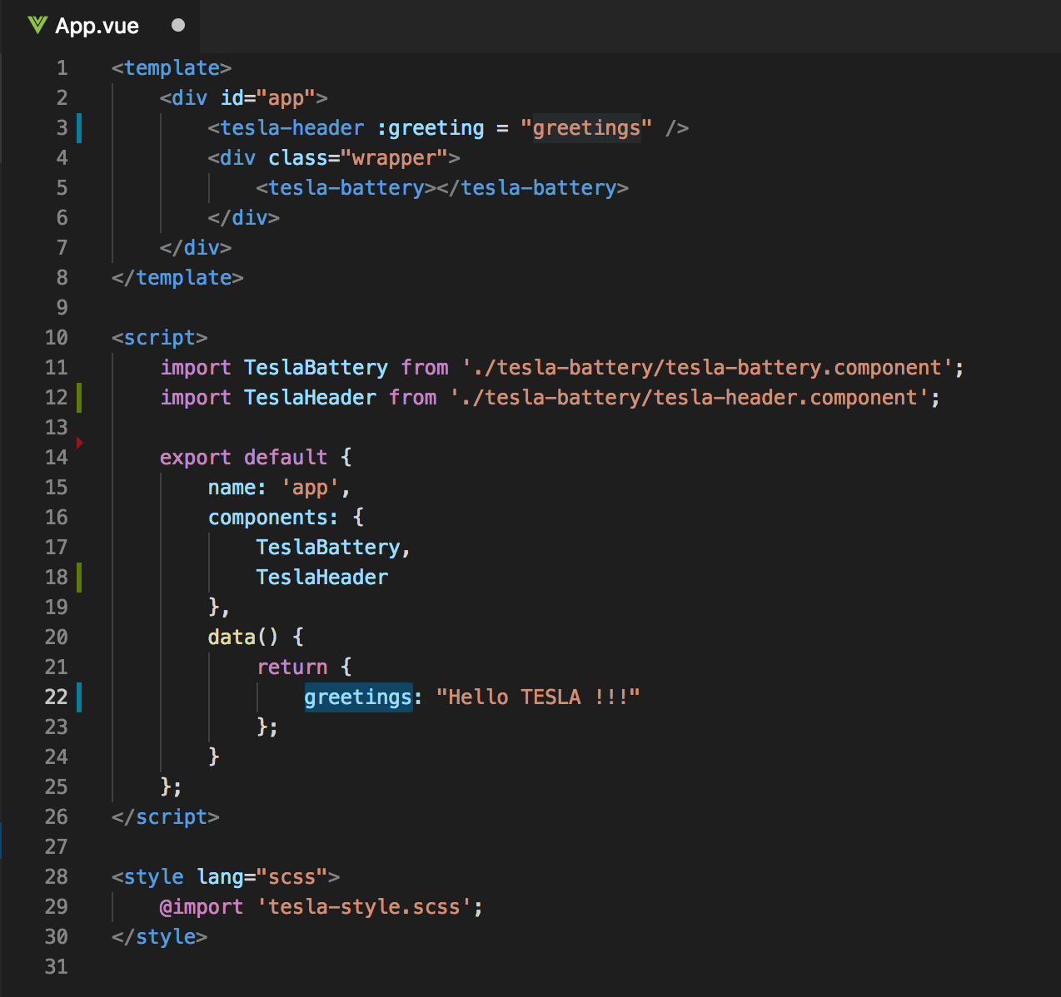
Step 2 Import tesla-header.component in App.vue
Old
New

Slide 53
Getting started
Clone or download:
https://github.com/petereijgermans11/workshop-reactjs-vuejs

Slide 54
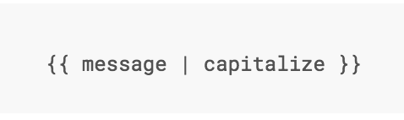
Filter
Notes:
Vue.js allows you to define filters that can be used to apply common text formatting.

Slide 55
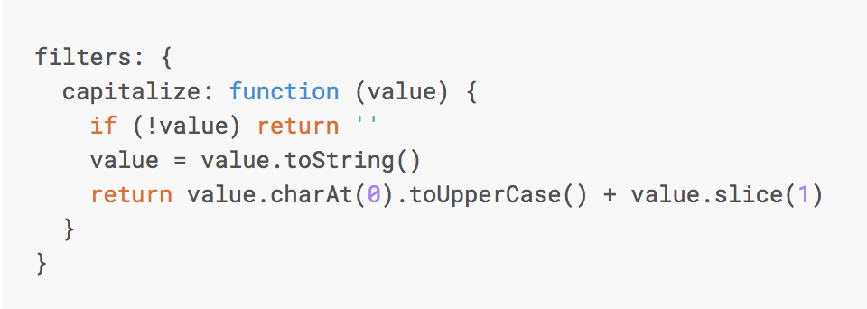
Custom Filter
Notes:
You can define local filters in a component’s options:

Slide 56
DIRECTIVES
Notes:
Directives are special attributes with the v- prefix. Directive attribute values are expected to be a single JavaScript expression (with the exception of v-for, which will be discussed later). A directive’s job is to reactively apply side effects to the DOM when the value of its expression changes.

Slide 57
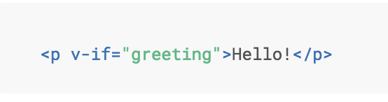
Directive v-if
Notes:
Here, the v-if directive would remove/insert the <p> element based on the truthiness of the value of the expression greeting.

Slide 58
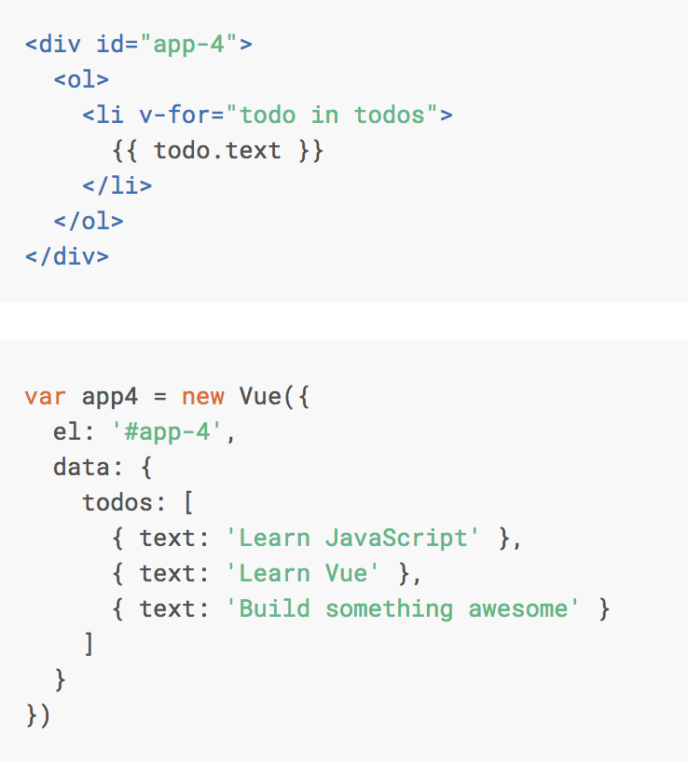
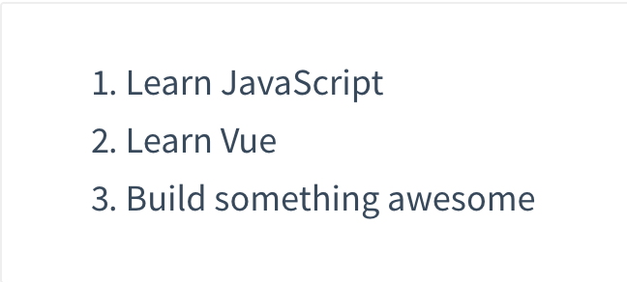
Directive v-for

Slide 59
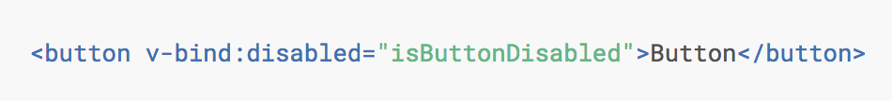
v-bind
Notes:
If isButtonDisabled has the value of null, undefined, or false, the disabled attribute will not even be included in the rendered <button> element.

Slide 60
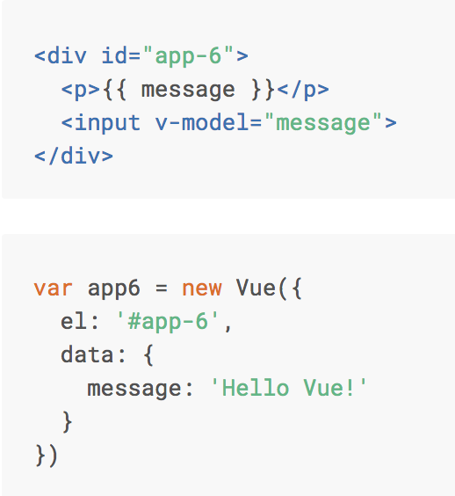
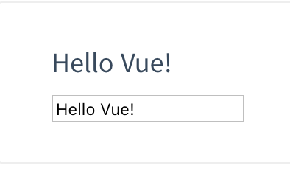
Directive v-model

Slide 61
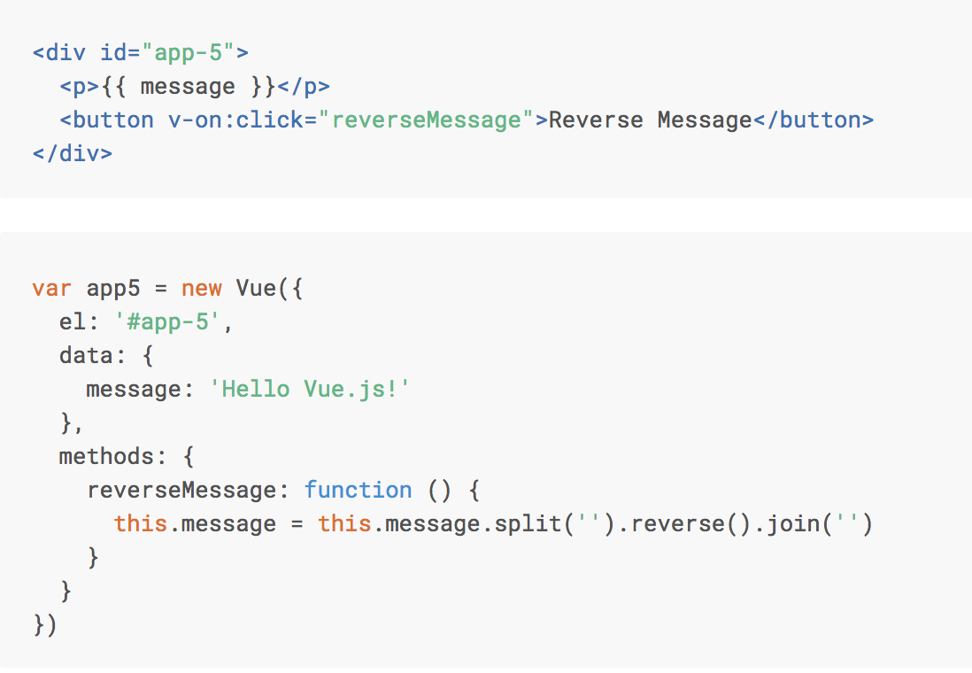
Directive v-on:click

Slide 62
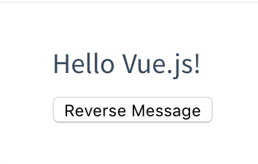
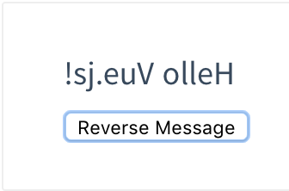
Directive v-on:click

Slide 63
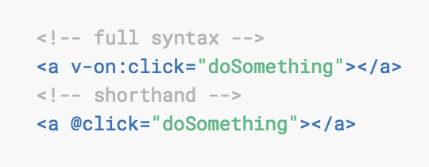
v-on:click Shorthand

Slide 64
@blur.stop.prevent

Slide 65
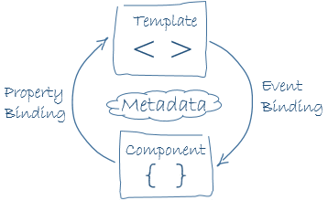
Data binding
view
model
Notes:
Component = model = data-object

Slide 66
Databinding (one way)
<span> Message: {{ message }} </span>
<img v-bind:src=“url/car.jpg”> → <img :src=“url/car.jpg”>
<div v-on:click=”speedup"> → <div @click=”speedup"></div>
Notes:
Interpolation
Vue.js uses Directives:
v-bind → To assign the ’logo’ and ‘url’ attribute to HMTL tag, we need to use v-bind directive or colon.
v-on:click → We can use the v-on directive to listen to DOM events (onClick-events). Here when the on-click event is fired: the speedup() will be called.

Slide 67
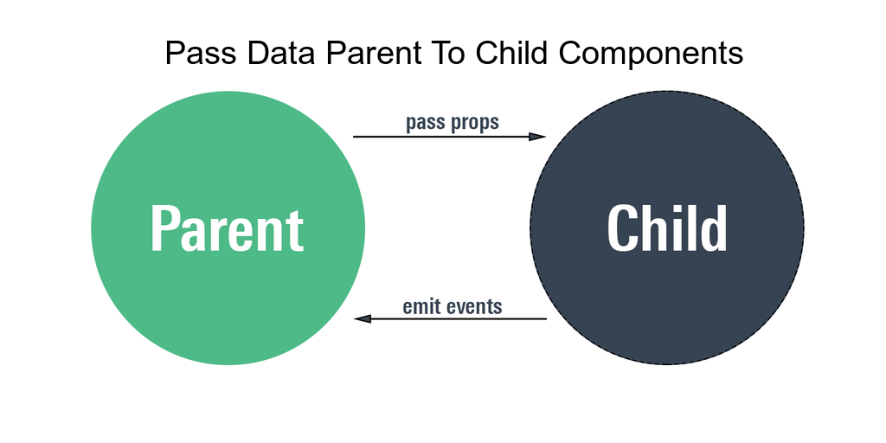

Slide 68
Presentational Component (stateless component)
Are concerned with how things look.
Usually have some DOM markup and styles of their own.
Receive data and callbacks exclusively via props.
Rarely have their own state (when they do, it’s UI state rather than data). A presentational Component is stateless

Slide 69
What are the benefits of using these patterns?
Better separation of concerns
Better reusability
Extract layout components to prevent duplication

Slide 70
Container Component (stateful component)
Are concerned with how things work.
Provide data and actions to presentational components.
Are often stateful, as they tend to serve as data sources.

Slide 71
TODO
Uitleg component
Uitleg data binding + 2 way databinding
@onBlur @onclick @onfocus. OF :onClick
Name, Props, data(), Methods, Computed() in Child components
Start app with root Vue: new Vue()
Computed properties en watchers

Slide 72
Virtual DOM Vue.js and React both use virtual DOM, which makes it faster
Notes:
less expensive:
The changes are not made to the DOM, instead a replica of the DOM is created which is present in the form of JavaScript data structures. Whenever any changes are to be made, they are made to the JavaScript data structures and the latter is compared with the original data structure. The final changes are then updated to the real DOM.

Slide 73
Live version
http://react-tesla-charge-calculator.surge.sh/

